Slide 1
Mantid Architecture
Straw man proposal
Nick Draper
24th August 2007

Slide 2
GAUDI strengths
The GAUDI framework has been built and supported in use for several years, and a lot of careful planning has gone into its design.
Adding new algorithms is relatively straightforward.
The GAUDI system has volumous amounts of documentation, however some of this is out of date
The GAUDI framework comes with several Histogram classes that provide built in functionality for free.
GAUDI has many associated services built in, of which several are useful.

Slide 3
GAUDI weaknesses
Designed to process event based data.
  Event loop, and assumptions based on this.
Heavy to compile and install
  linked packages ROOT, HBOOK etc
JobOptions files are confusing and do not fit with ad-hoc or iterative anaylsis.
The implicit use of converters makes understanding of the framework difficult.

Slide 4
Proposed architecture
Based on GAUDI.
Rewritten with neutron scattering in mind.
Start from a blank project
  Add & edit classes from GAUDI one at a time.
  Write unit tests for each class.
  Gain a better understanding of the inner workings.
  May initially be slower than starting with GAUDI as a whole.

Slide 5
Changes from GAUDI
The event loop inherent in the architecture will be removed and replaced by a more flexible analysis workflow.
All references to the ROOT, HBOOK and GEANT4 software packages will be removed
  Replaced where necessary by light weight implementations with greater relevance to the neutron scattering.
Converter architecture used for implicit loading and saving of data to persistent stores will be replaced by explicit algorithms to load and persist data.
A new type of temporary data service - Managed Data Service
  Actively manage the memory use of the objects contained within it.
Job Options - split the system wide settings from the algorithms settings and workflow.

Slide 6
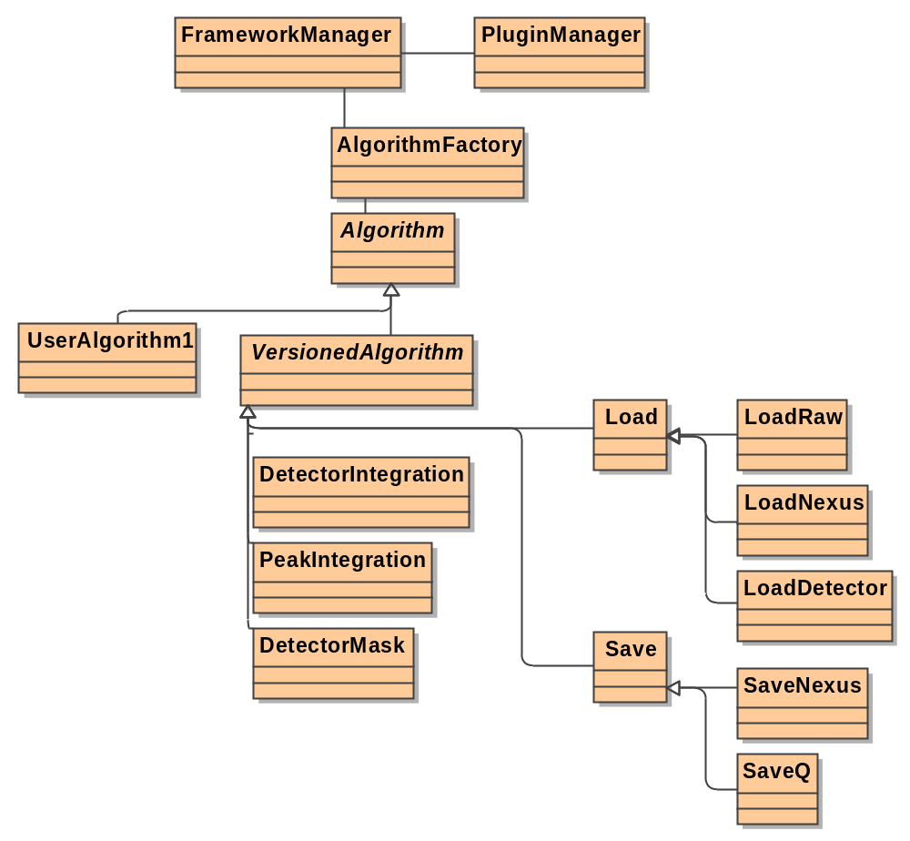
Algorithms & Persistency

Slide 7
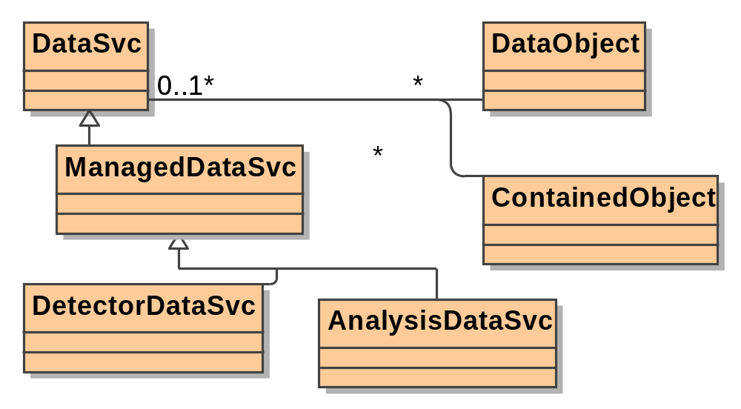
Temporary Data Services

Slide 8
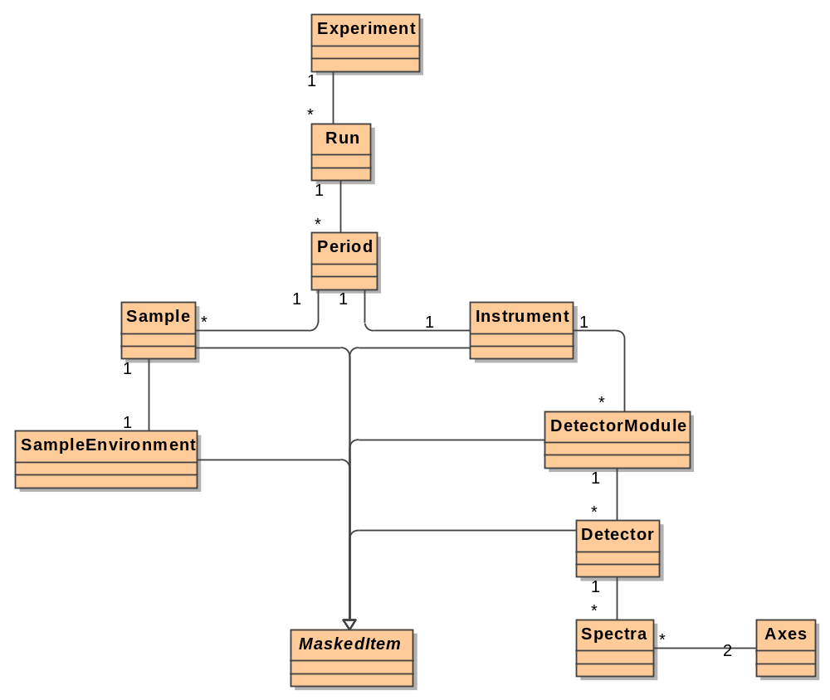
Data Structure (1)

Slide 9
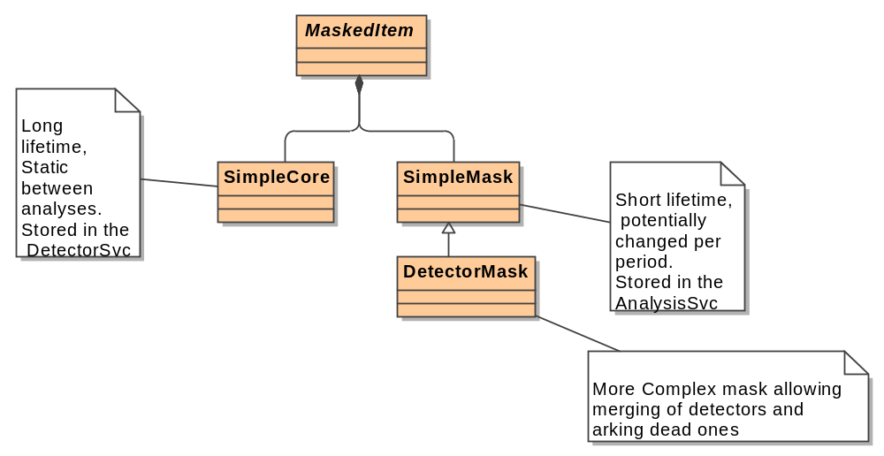
Data Structure (2)

Slide 10
Concerns
What about workspaces?
  Perhaps data objects that can be mapped on top of other data?
How does the GAUDI - python integration fit with this.
Team resources.

Slide 11
Suggested timeline
28 Aug – 10 Sept
  Architecture design document, complete draft and review
07 Sept
  First Prioritisation meeting
10 Sept – 8 Oct
  First development cycle

